Slide 1
Game Security

Slide 2
About me
Name:
Kelvin Chan
Work :
Working in Game Security Research and development department of Tencent.
Responsibility :
Windows Kernel Research and Windows Driver development, Solution provider, and data analysis.

Slide 3
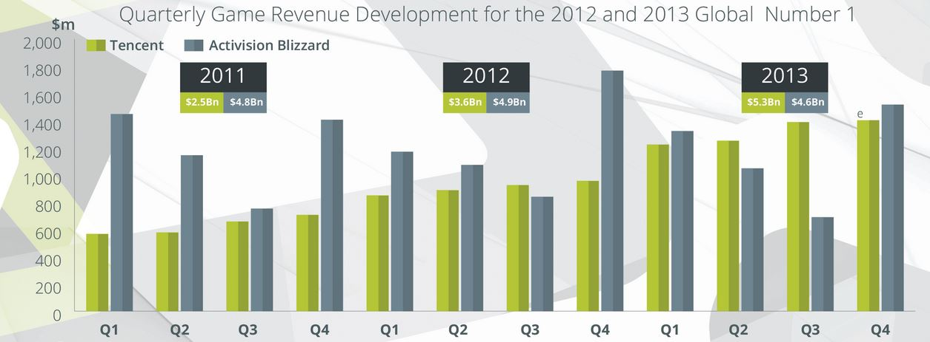
Why Game security?

Slide 4
Why R&D team exist?
Active defensing
Law cannot provide a instant help.
Cheating is directly affect Game Company Revenue

Slide 5
Who hack?
Players
Game cheat studio
Personal Hacker

Slide 6
Defeating Game Cheaters

Slide 7
Type of Game Hack
There are three major type of game cheating :
Keyboard and mouse emulation
Memory hack
Packet emulation

Slide 8
Keyboard and Mouse emulation

Slide 9
Memory hack

Slide 10
Packet emulation

